Slide 1
Probability and non probability Sampling

Slide 2
PROBABILITY RANDOM SAMPLING
Probability Sampling is a sampling technique in which sample from a larger population are chosen using a method based on the theory of probability. For a participant to be considered as a probability sample, he/she must be selected using a random selection
The most important requirement of probability sampling is that everyone in your population has a known and an equal chance of getting selected.
Population is denoted by N, The value of population is known as parameter
For example, N₌ (2,4,6) 2+4+6/3 = 12/3 ----
N= 4
Parameter would be constant of every population , the value of sample would variate and is known as statistic

Slide 3
Types of PROBABILITY RANDOM SAMPLING
Simple random sampling
Stratified Random Sampling
Cluster Random Sampling
Systematic Random Sampling

Slide 4
Simple RANDOM SAMPLING
Random method of data collection
equally likely and independent chances of selection
every unit has equal chance of occurrence
Methods
Fish bowl method
Lottery method
Computer software
Random Table

Slide 5
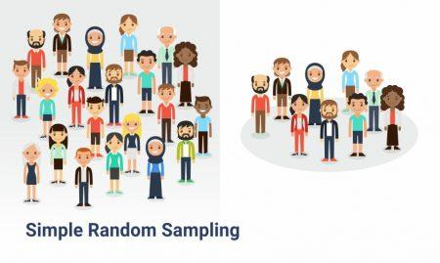
Simple random sampling

Slide 6
Systematic sampling
Every “nth” individual to be a part of the sample. For example, you can choose every 5th person to be in the sample
Total population is known
On the basis of selected interval, sample is selected from the total population
It is known as periodic interval or sampling interval

Slide 7
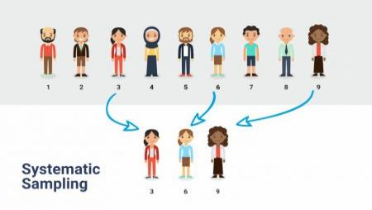
Systematic sampling
For Example, every 3rd unit selected would be a sample

Slide 8
Systematic sampling

Slide 9
Cluster sampling
In cluster sampling, instead of selecting all the subjects from the entire population right off, the researcher takes several steps in gathering his sample population
The total population is divided into different clusters, which are homogenous groups based on some common characteristcs
the researcher selects groups or clusters, and then from each cluster, the researcher selects the individual subjects by either through simple random sampling or systematic sampling

Slide 10
Cluster sampling
Geographical division can also be a source of making different clusters . There fore, is a way to randomly select participants when they are geographically spread out. For example, if you wanted to choose 200 participants from the entire population of the Pakistan, it is likely impossible or difficult to get a complete list of everyone. Instead, the researcher randomly selects areas (i.e. cities or counties) and randomly selects from within those boundaries in order to get the representation of population within its sample from every area
Mostly cluster sampling technique is used in large population

Slide 11
Cluster sampling
For instance : City, family, university, population of organizations, ethnic groups, tribes, cultural groupings etc.
Method :
Step I: Decide the target population, total population would be usually known
Step II: Decide the size of the sample—n
Step III: Formation of cluster on the basis of some common /similar characteristics , average members in each groups should be same
Step IV: Place the sample units in the clusters on the basis of simple random sampling and sampling interval to get the required sample size

Slide 12
Cluster sampling
Categories
Cluster sampling can be two stage, three stage or multi stage cluster sampling
Single Stage Cluster Sampling: As the name suggests, sampling will be done just once
Two-Stage Cluster Sampling: A sample created using two-stages is always better than a sample created using a single stage because more filtered elements can be selected which can lead to improved results from the sample
Multiple Stage Cluster Sampling: For effective research to be conducted across multiple geographies, cluster sampling can be used

Slide 13
Stratified random sampling
It is also done where a researcher intends to transform a heterogeneous population into homogeneous groups on the basis of some correlated characteristics
The researcher attempts to stratify the population known as stratum or strata on the basis of the characteristics on basis of which it is stratified
Stratified random sampling can be proportionate or disproportionate

Slide 14
Stratified random sampling
Method:
Step I- Identify all elements or sampling units in the sampling population
Step II: Decide the different strata , which are denoted by k
Step III: Pacing elements into each stratum
Step IV: Decide the total sample size –n
Step V: Use proportionate or deprotonate random sampling technique

Slide 15
Stratified random sampling
Disproportionate stratified random sampling
Determine the number of elements to be selected from each stratum
sample size/no. of strata (k)
For example….. 200/10 ₌ 20 ( 20 sample would be selected from each stratum)
Select the required number of elements from each stratum by simple random sampling

Slide 16
Stratified random sampling
Proportionate stratified random sampling
Determine the proportion of each stratum in the study population (p) = elements in each stratum/ total population size
For example : 20/500= 0.04
Determine the number of elements to be selected from each stratum= sample size * p
For example: 200* 0.04 = 8
p 1= 8
Select the required number of elements through each stratum by simple random sampling

Slide 17
Non Probability sampling
In non probability random sampling population is unknown
For this reason, every element of the population does not have equal chance of occurrence
Mostly sample are selected based on selective judgements meaning that their own inclusion in the part of selection of sample remains there ( they are not based on random selection)
Procedures used in non probability sampling are more easier

Slide 18
Types of non probability sampling
Quota sampling
Purposive sampling
Snow ball sampling
Convenient sampling

Slide 19
Quota sampling
Choosing the relevant stratification and dividing the population accordingly in mutually exclusive groups
Calculating a quota for each group
Continuing to invite cases until the quota for each group is met
Any characteristics can be chosen for stratification
Quota sampling is particularly useful when you are unable to obtain a probability sample, but you are still trying to create a sample that is as representative as possible of the population being studied

Slide 20
Purposive sampling
Purposive sampling, also known as judgmental, selective or subjective sampling, reflects a group of sampling techniques that rely on the judgement of the researcher when it comes to selecting the units (e.g., people, cases, events, case study of data) that are to be studied
Researcher’s own input in purposive sampling in deciding the sample is very obvious
The main goal of purposive sampling is to focus on particular characteristics of a population that are of interest, which would best enable you to answer your research questions
Types of purposive sampling includes maximum variation sampling, homogeneous sampling, expert sampling

Slide 21
Snow ball sampling
Snowball sampling is particularly appropriate when the population you are interested in is hidden and/or hard-to-reach
in this technique researcher tries to identify one or more units in the desired population
Later by using these units, further units are find out and so on until the sample size is met

Slide 22
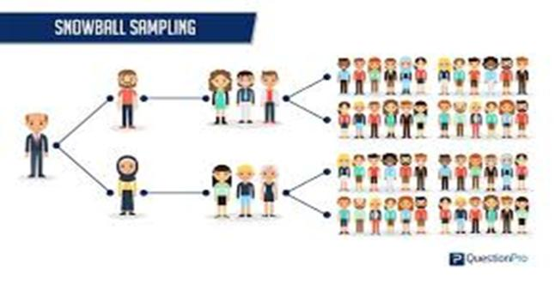
Snow ball sampling

Slide 23
Convenient sampling
A convenience sample is simply one where the units that are selected for inclusion in the sample are the easiest to access.
If we were only interested in achieving a sample size of say 100 students, we may simply stand at one of the main entrances to campus, public opinion polls are usually conducted by using this technique
In convenient sampling, sample elements becomes ‘ convenient source ‘ of data. The criteria of sample selection is not based on expert judgement as it is in purposive sampling , rather availability and access to a particular respondent becomes a source of decision of selecting the sample

Slide 24
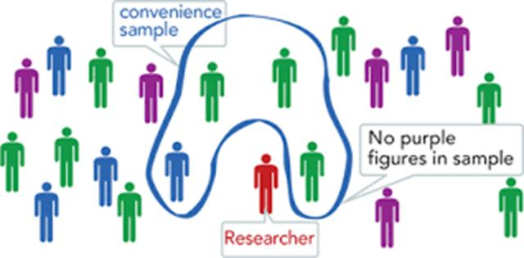
Convenient sampling

Slide 25
Techniques of probability and non probability random sampling can be used in quantitative, qualitative and mixed method research

